Slide 1
Administering your Additional Voluntary Contributions (AVC) payroll
Training guide
Approved for use with employers and payroll administration staff

Slide 2







Our end-to-end AVC payroll submission process
We issue our monthly payroll listing with changes and new members
Payroll administration receive payroll listing
Payroll administration check listing for changes and update payroll file
Payroll administration create new payroll file
Payroll administration submit payroll file and make Bacs payment
We complete validation checks
We receive payroll file and payment, auto-match and upload into system for investment

Slide 3
Submitting AVC payroll information correctly and in a timely manner
If there are any errors with the payroll files and payments sent to us:
We won’t be able to invest the contributions onto member records. We’ll return the uninvested contributions to you.
It could have detrimental financial consequences to all members contained in the payroll file, as they’ll be unable to claim or transfer their funds when they need them.
It could result in a report being made to the Regulator.
It can cause tax payments and member benefit statements to be incorrect, specifically if the payroll file contains the wrong contribution types. This is important where payments are made by a salary sacrifice arrangement.
We’ll always let you know how to correct the errors and will ask you to amend and resend the payroll file and/or payment.
If you need help or have any questions about your payroll files or payments, please contact us at avc.cashschedules@prudential.co.uk
Guidelines for formatting and sending payroll files and payments is available at: mandg.com/pru/workplace-pensions/employers/guide-to-administering-your-payroll

Slide 4
Payroll submission rules
Payroll files must be sent in CSV (Comma Delimited) file format.
Payroll files must be named using our specified format of
XXXX_ZZZZZZ_DDMMYYYY_MMYY_Name
For example: L002_E00000_19012022_0122_Prudential.csv
You must submit one payroll file and one payment per payroll, per pay period.
We process payroll files in chronological order. For example, we’ll process February’s file before March - even if February’s hasn’t been received or has errors.
Teachers’ AVC and Local Government AVC contributions must be kept separate and submitted on different payroll files and Bacs payments.
If you have a mixture of members paying Standard AVCs and Salary Sacrifice Shared Cost AVCs (SSSCAVC), they must be submitted on the same file. Please don’t send separate payroll files.
Payroll files must be submitted first, before the payment is made. We need to receive the payroll file by the 22nd of the following month.
Negative amounts are not permitted on a payroll file and will cause the file to fail system validation.
The total amount on the payroll file must equal the Bacs payment submitted.
XXXX | Your scheme code e.g. L002
ZZZZZZ | Your unique payroll number
DDMMYYYY | Date the payment is due e.g. 19012022
MMYY | Payroll period number. Must be sequential and can be calendar monthly or financial year monthly e.g. 0122 for Jan 2022, or the week of the year e.g. 2622 for the 26th week of the year
Name | Text to describe the file and is maximum of 10 letters, e.g. the employer’s name or the payroll name

Slide 5
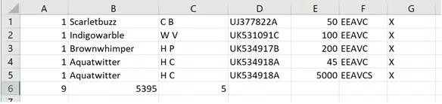
Creating and formatting a payroll file
Open Excel and click on ‘Blank workbook’.
Click ‘File’ then ‘Save As’.
Name the file using the naming format ‘XXXX_ZZZZZZ_DDMMYYYY_MMYY_Name’
Change the file type to ‘CSV (Comma delimited)’ then click on ‘Save’.
Add the contribution information as below. Member data must start from Row 1 i.e. without column headers.
Once all contribution information has been added, click on ‘Save’.
The final row of the file is the trailer record. This tells the system that there is no further member data to be processed. It should be formatted/completed as below:
The completed payroll file should look like this:
Please note: If a member is making two contributions with different contribution types, they need to be recorded as two separate entries (as shown in Rows 4 and 5 above).
Trailer record | Column A | Column B | Column C
Description | Value will always be 9 | Sum of all contributions | Total number of member records
Format | 9 | Numbers with two decimal places. No £ sign | Numeric. No comma or decimal point
Column | Column information | Description
A | Record type | Value will always be 1
B | Member name | Upper and lower case letters, hyphens, apostrophes and spaces are allowed
C | Member initials | Upper case letters and spaces allowed. No full stops
D | NI number | Numbers and upper case letters
E | Contribution amount | Numbers with two decimal places. No £ sign
F | Contribution type | For Standard AVC, use EEAVC for regular payment and EEAVCS for single payment. For LG SSSCAVC, use ERREG for regular payment and ERSGL for single payment. Upper case letters
G | Premium code | Always set to X

Slide 6
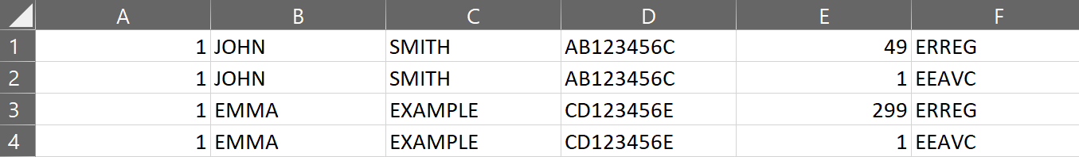
Creating and formatting a payroll file (continued)
For SSSCAVC members
Regular contributions should be recorded across two lines on the same payroll file – one row for the employer contribution (ERREG) and the second for the employee contribution (EEAVC).
If you have a mixture of members paying Standard AVCs and Salary Sacrifice Shared Cost AVCs (SSSCAVC), they must be submitted on the same file. Please don’t send separate payroll files.
Members that are not included on our payroll listing shouldn’t be on the payroll file you send us. This includes new members joining and existing members changing their contributions. If there are missing members or the listing doesn't match a third party listing, please contact us at corporate.pension.enquiries@prudential.co.uk

Slide 7
Sending Bacs payments
All payments must be made by Bacs and should be sent no more than three days after the payroll file has been sent.
The payment value must match the payroll file value.
Payments should not include any under-payments or over-payments. If a refund is due for a previous over-payment, please contact us to arrange this.
Bacs payments should be sent to:
The following Bacs fields must be completed for us to receive the money:
Field # | Field title | Content
1 | Destination Sort Code | 400250
2 | Destination Account Number | 31029142
3 | Destination type of Account Code | This field is always zero – 0
4 | Transaction Code | Direct Credit code is 99
5 | Originating Sort Code | The sort code from which payment is being made
6 | Origination Account Number | The account number from which payment is being made
7 | Free format | Always 0000
8 | Amount in pence | Total value in pence of the payment being made
9 | User’s name | Name the account is registered to
10 | User reference | User reference format and example: L02104352010621 L021: Scheme code. Four alphanumeric characters. 04352: Pay point number. Your unique payroll number 010621: Due date. Six numeric characters, DDMMYY format.
Account Name | Prudential Assurance Company Ltd PRU BACS Receipts
Destination Sort Code | 400250
Destination Account Number | 31029142
Branch Address | HSBC, London, City of London Corporate Office PO Box 125, 8 Canada Square, London, E14 5XL

Slide 8
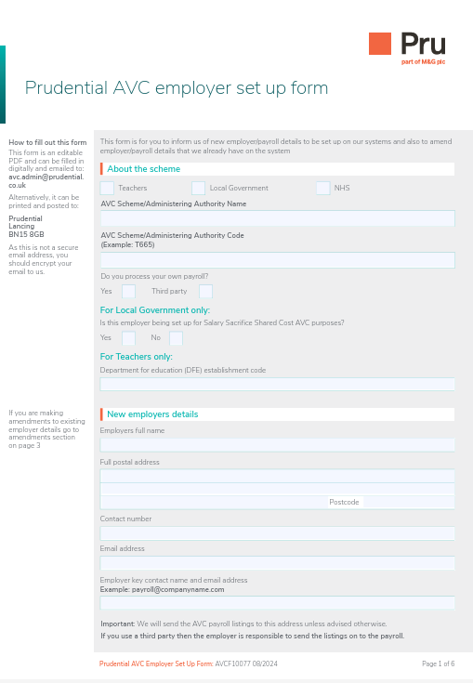
Let us know of any payroll changes
Please complete our employer set up form to inform us of:
New employer or payroll details to be set up on our systems
Amend existing employer or payroll details. For example, change to employer name, address and change of payroll provider or a school that is joining or leaving an academy trust.
This must be sent to us before sending any payroll files or payments. We’ll get in touch once we have made the relevant changes/additions – this is when you’ll be able to send the relevant payroll file and payment.
To access the form, please visit:
mandg.com/dam/pru/shared/documents/en/avcf10077.pdf.

Slide 9

‘Prudential’ is a trading name of The Prudential Assurance Company Limited which is registered in England and Wales. Registered Office at 10 Fenchurch Avenue, London EC3M 5AG. Registered number 15454. Authorised by the Prudential Regulation Authority and regulated by the Financial Conduct Authority and the Prudential Regulation Authority.

